Slide 1

Centre Foundation’s
2026 Grant Information Session
Notes:
TY for joining us for this webinar to learn about Centre Foundation’s 2026 grant calendar and upcoming opportunities

Slide 2

Your Hosts
Krista Williams, Grants and Scholarship Coordinator
Nathaniel Rasmussen, Community Impact Director
Notes:
And we’re so excited to be able to share this information with you today

Slide 3
Agenda
Grantee Eligibility
Accessing the Grant Portal
Grant Opportunities for Organizations
Other Ways to Partner with Centre Foundation
Notes:
Q&A at end; mention that a recording of this webinar and a copy of the slides will be sent to all registrants and posted on CF’s website

Slide 4
Centre Foundation
Community Foundation serving Centre County since 1981
Our mission: Centre Foundation fosters a culture of giving, supports and empowers nonprofits, and sparks positive community change.
Over $5m invested in our community annually through programs, scholarships, and grants

Slide 5
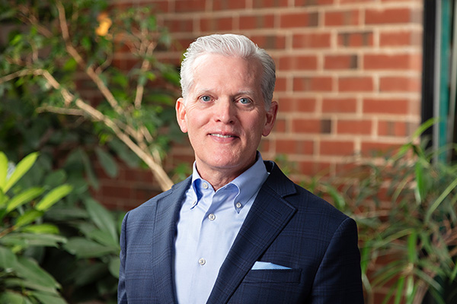
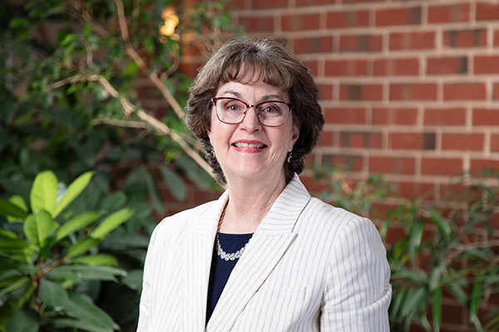
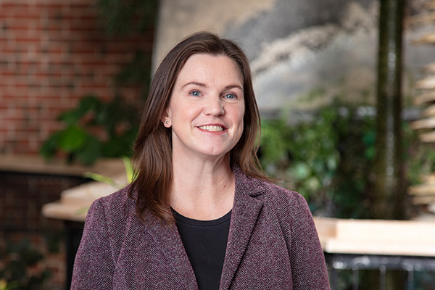
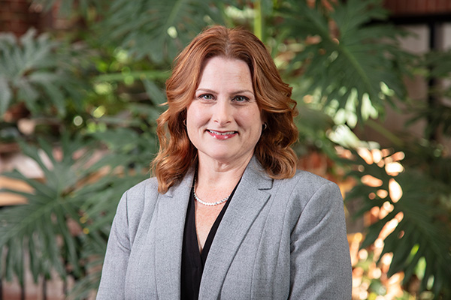
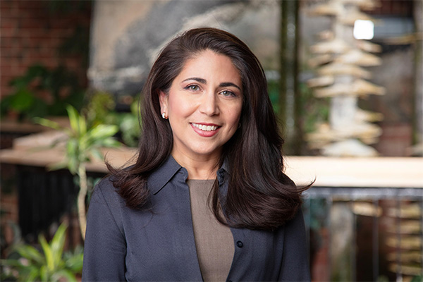
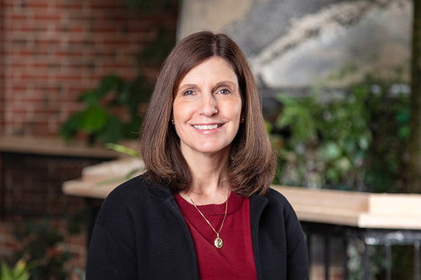
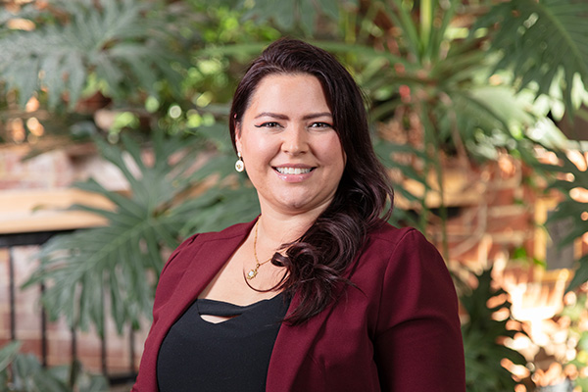
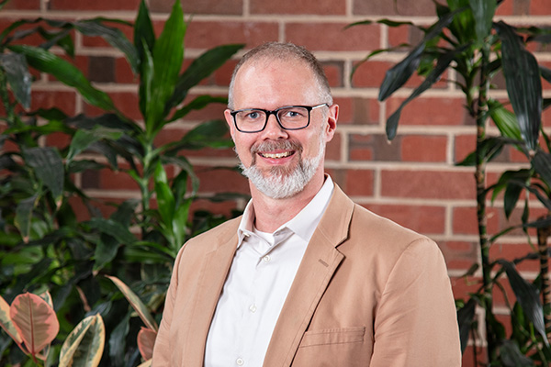
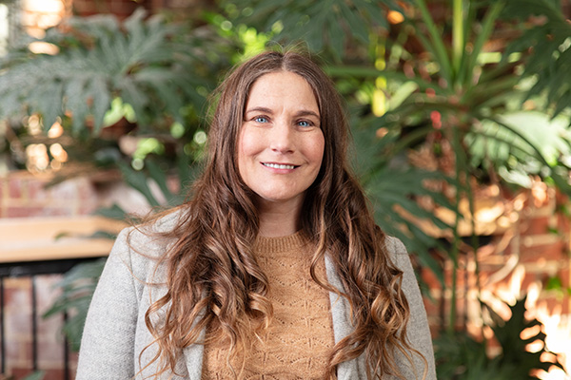
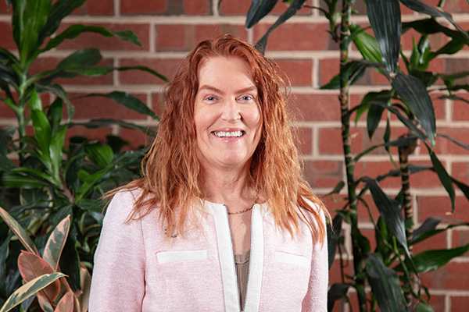
Our Team
Dave Lieb
President and CEO
Carrie Ryan
CFO/COO
Kerry Tolton
Development and Stewardship Director
Andrea Walter
Accounting Director
Melissa Lopata
Marketing and Communications Director
Krista Williams
Grants and Scholarship Coordinator
Maddie Saldaña
Stewardship Coordinator
Nathaniel Rasmussen
Community Impact Director
Jess Wilson
Front Office Executive Assistant
Joy Vincent-Killian
Press Forward PA Wilds Director
Notes:
All of this is made possible through the dedication of our wonderful staff

Slide 6
Grant Eligibility and Guidelines

Slide 7
Grantee Eligibility
Must be classified as a 501(c)(3) public charity under the Internal Revenue Code (this does not apply to government agencies or public-school districts)
Must file IRS Form 990 (or 990-EZ or 990-N) annually
Must register with the PA Bureau of Charitable Organizations (BCO-10)
Must provide services directly to Centre County
Funded programs must comply with Centre Foundation’s Nondiscrimination Policy
Must be in good standing with previous Centre Foundation grants
Notes:
Each grant program may have its own specific guidelines or requirements; typically speaking, these are the requirements you’ll need to meet for most of our opportunities
Must be classified as a 501c3 public charity under the IRS. This does not apply if you are a gov agency or public school district.
Your org must file a IRS Form 990 annually. This is either the 990EZ or 990N which is the postcard
Must register with the PA Bureau of Charitable Organizations. This is your annual BCO-10. there is more info on our website about the bco-10
Must provide services directly to CC
Non disc policy will not fund organizations or projects that unlawfully discriminate against participants in your program
All previous grant reports are up to date
See if Nathaniel has anything to add

Slide 8
Grantee Eligibility
Things we do not fund:
  Lobbying or political activities
  Sectarian religious activities
  Reimbursement for expenses incurred before grant is awarded
  Requests from individuals
Notes:
Churches and religious orgs are eligible to apply for grants if they have programs that serve the entire community such as a food pantry or clothing drive
For things like rent or utility assistance – we refer folks to local organizations that are better equipped to provide these types of services

Slide 9
Grant Portal
Notes:
To apply for a grant from centre foundation, you’ll need to use our online grant portal, which is a product of Foundant – we introduced this system in late 2022

Slide 10
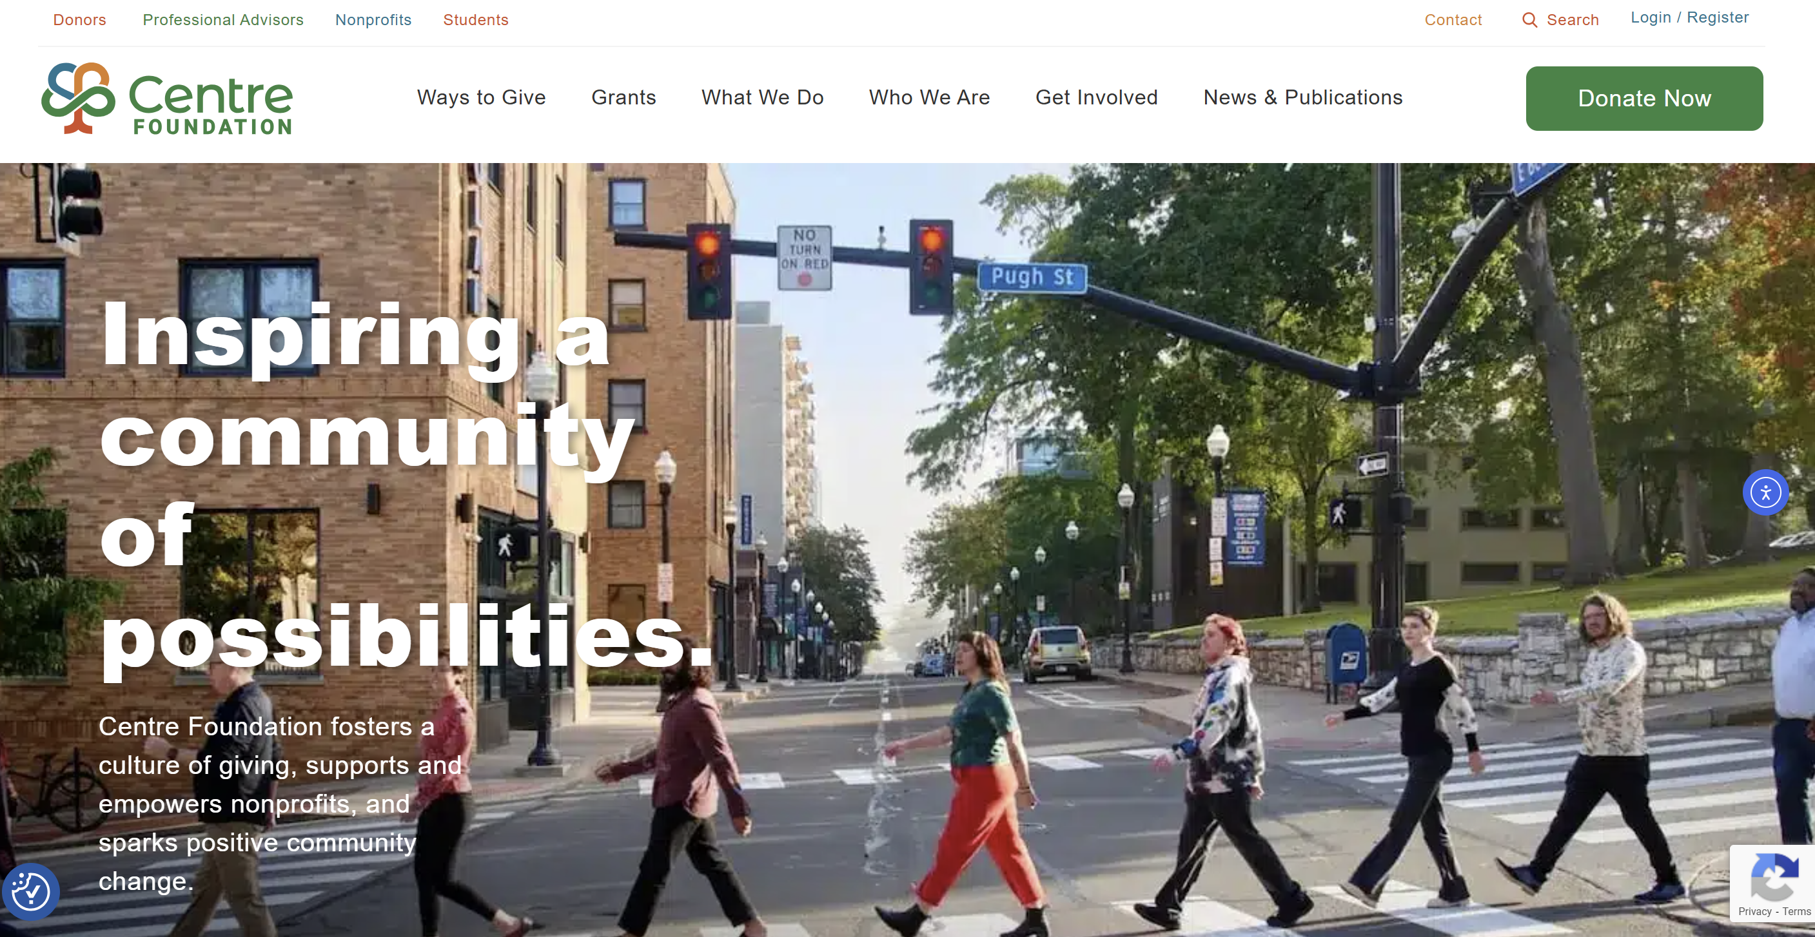
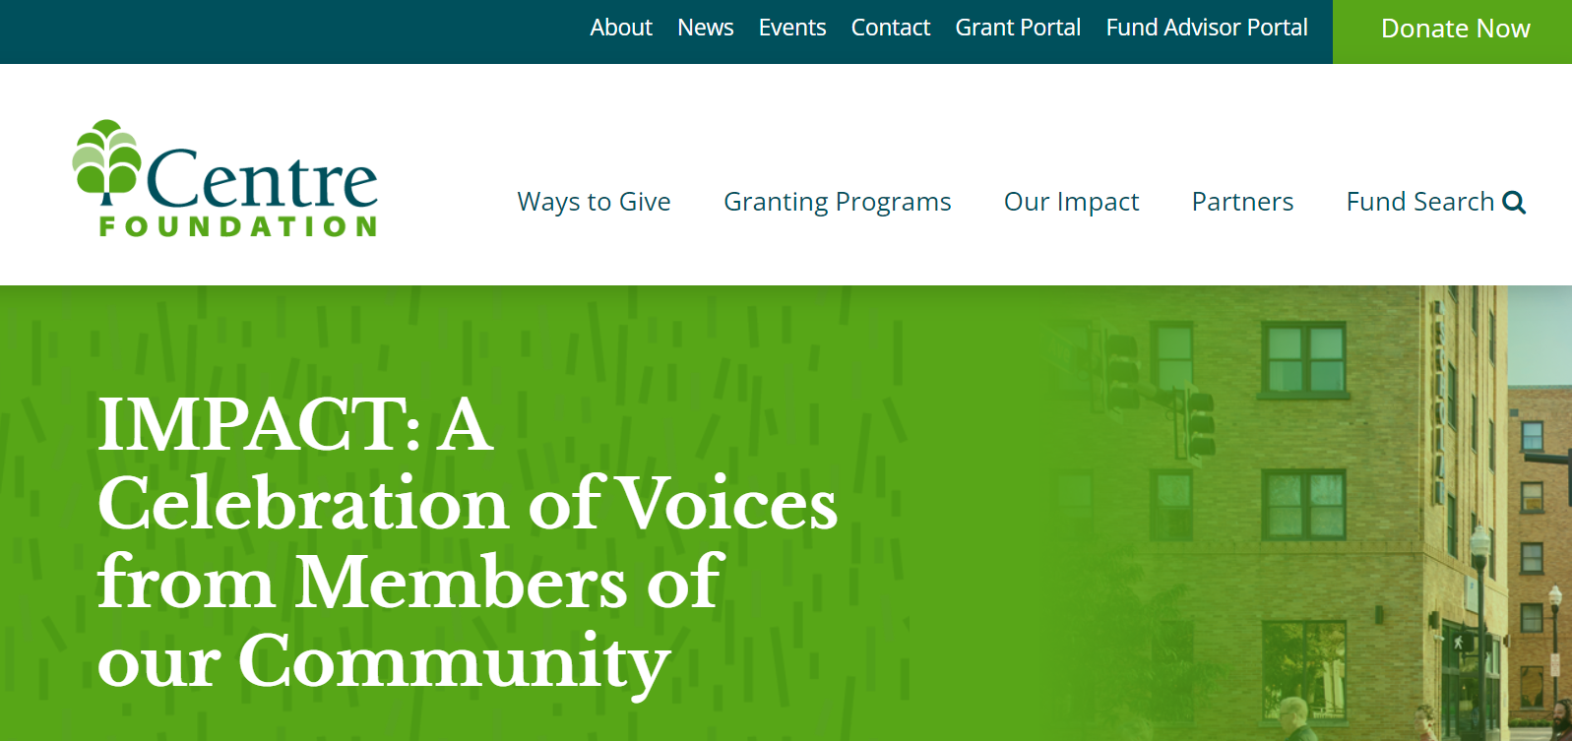
Accessing the Grant Portal
http://www.centrefoundation.org/
Notes:
New website. Click on Grants tab

Slide 11
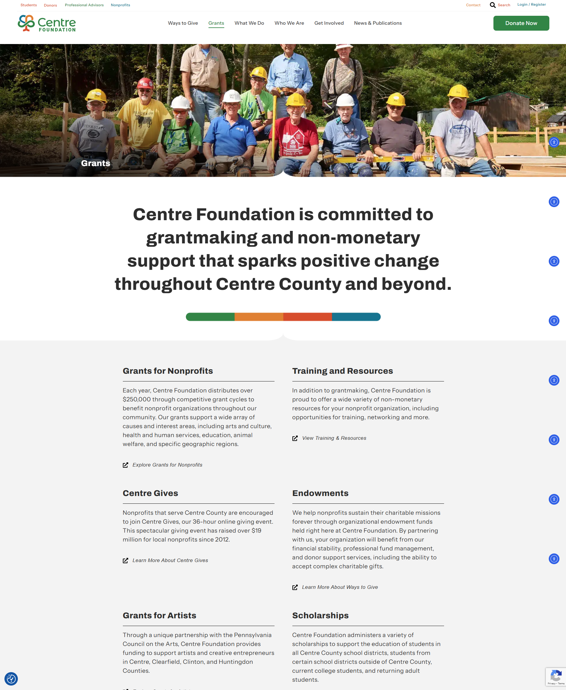
Accessing the Grant Portal
Notes:
this will list all of our competitive grants

Slide 12
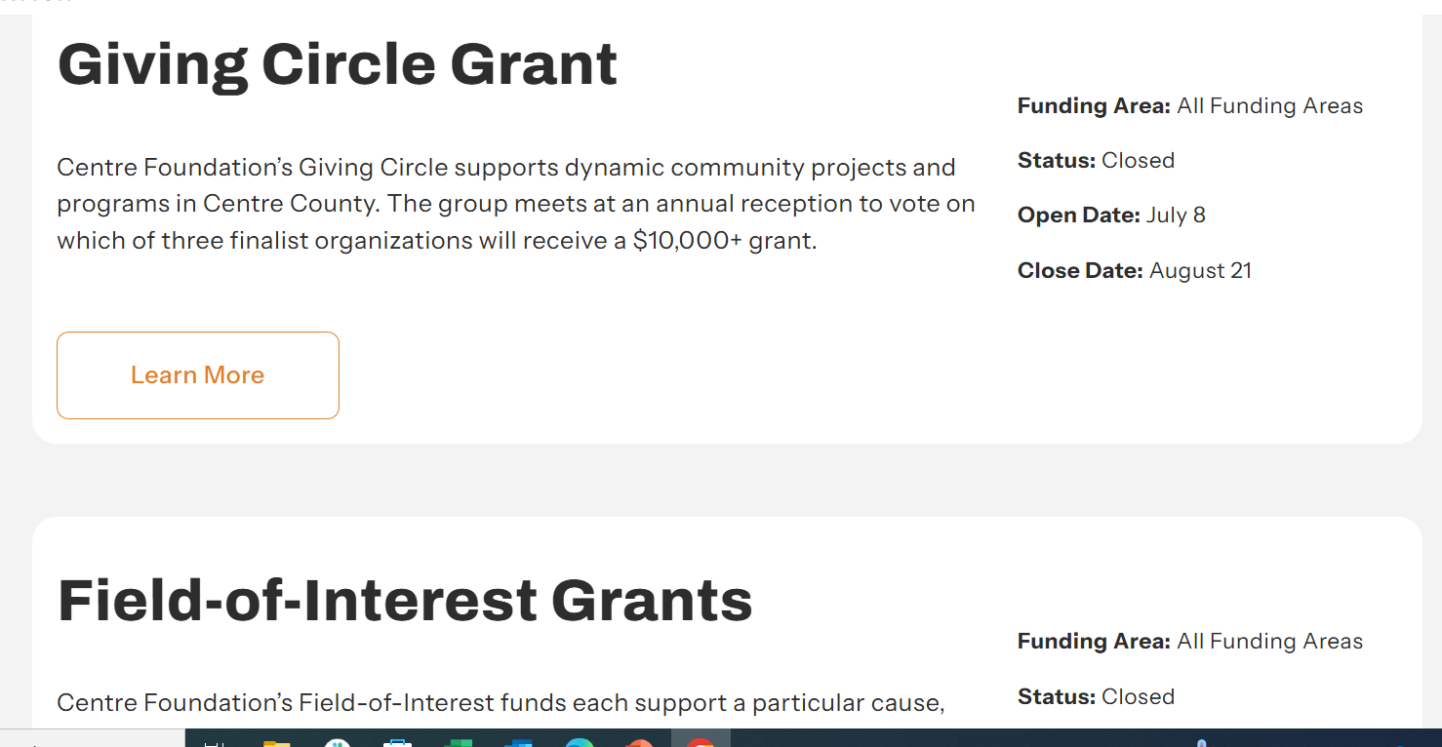
Accessing the Grant Portal

Slide 13
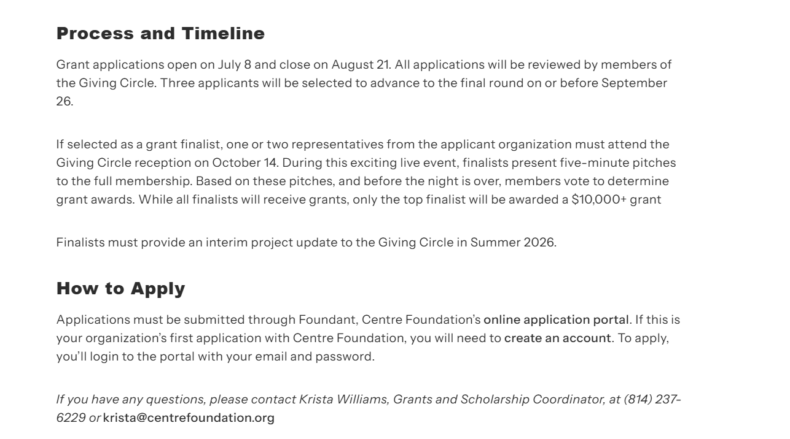
Accessing the Grant Portal
Notes:
This page will have more information on the grant. At the bottom, under How to Apply, there is a link to our grant portal

Slide 14
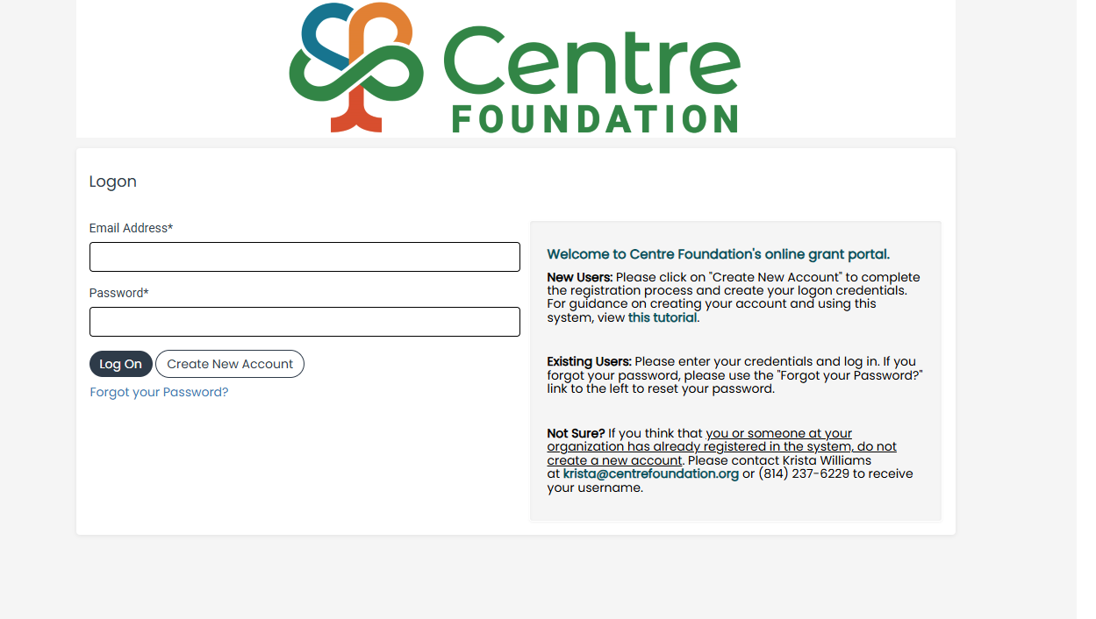
Log On Screen
Notes:
Explain reset password;
Note: If you believe someone from your organization has already created an account or you are not sure – please reach out for assistance

Slide 15
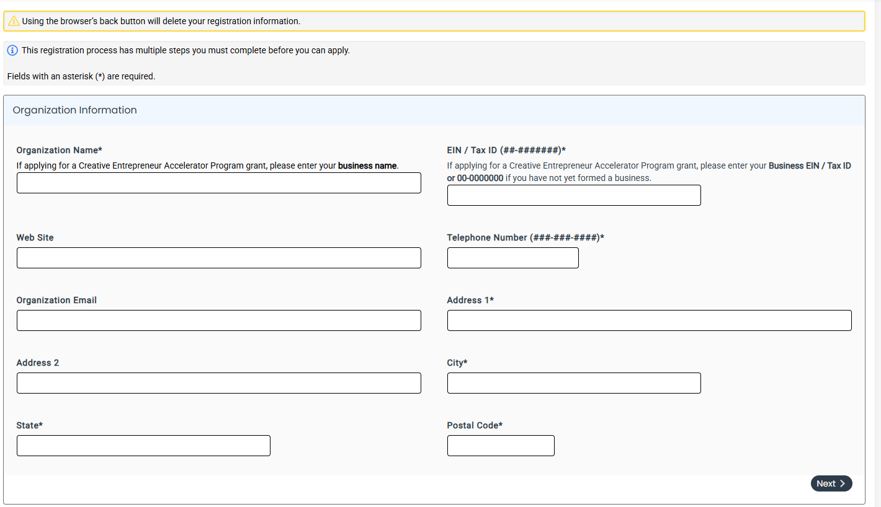
Creating a New Account
Notes:
EIN already in use – contact our office by phone or email and we can help you get logged in

Slide 16

Grant Portal Features
Apply for grants, view grant history, and submit follow-ups
Preview grant application questions
Auto-Save
Collaborate with colleagues
Option to receive Foundation staff feedback – must submit application at least two weeks before final deadline

Slide 17
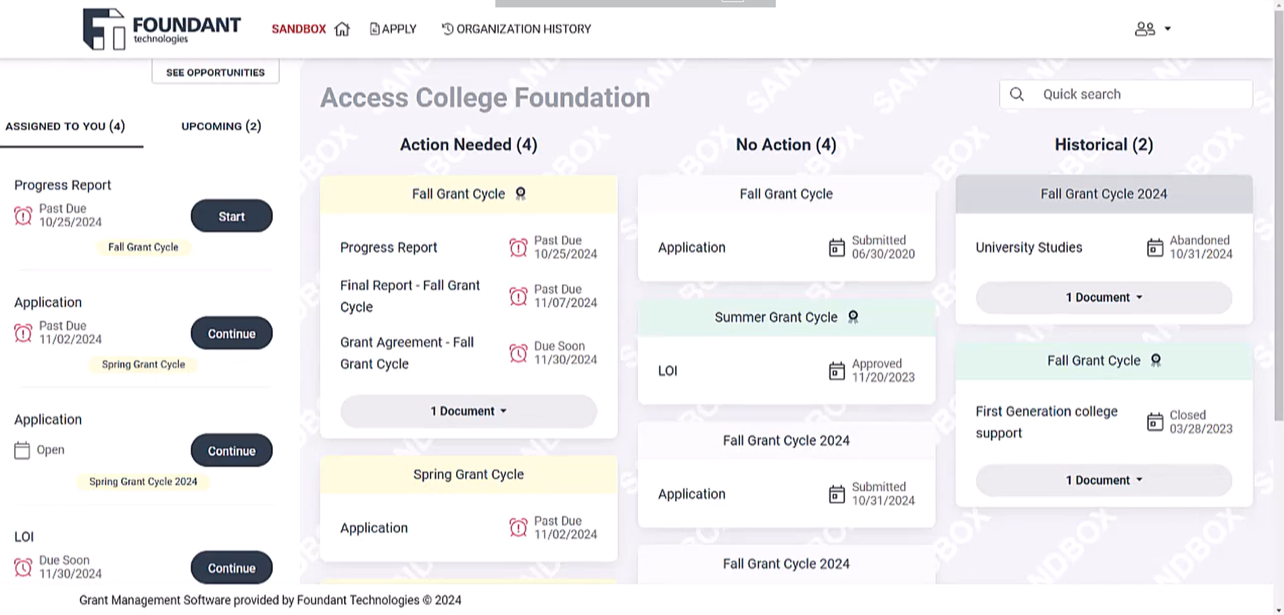
Dashboard

Slide 18
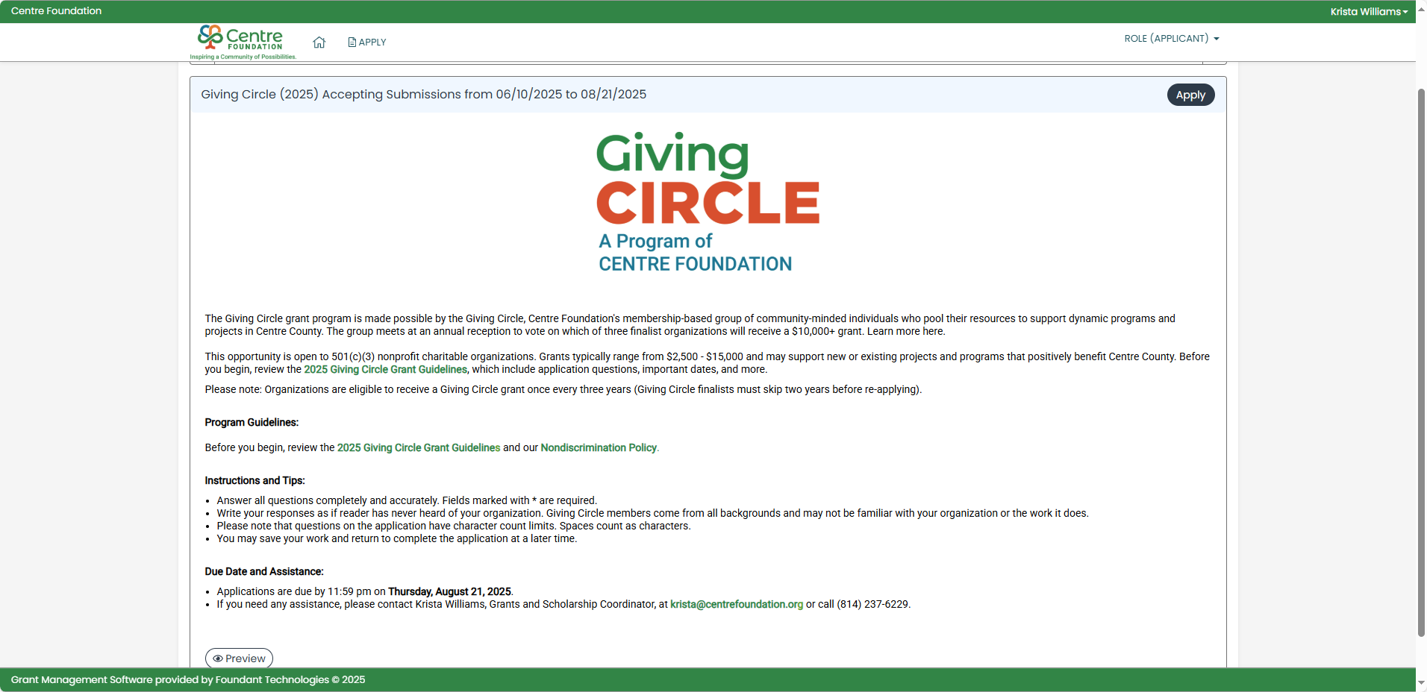
Apply Page
Notes:
Home button at top will always take you to your orgs dashboard. Hit Apply at the top for a list of all open grant applications

Slide 19
Grants & Community Impact Opportunities

Slide 20
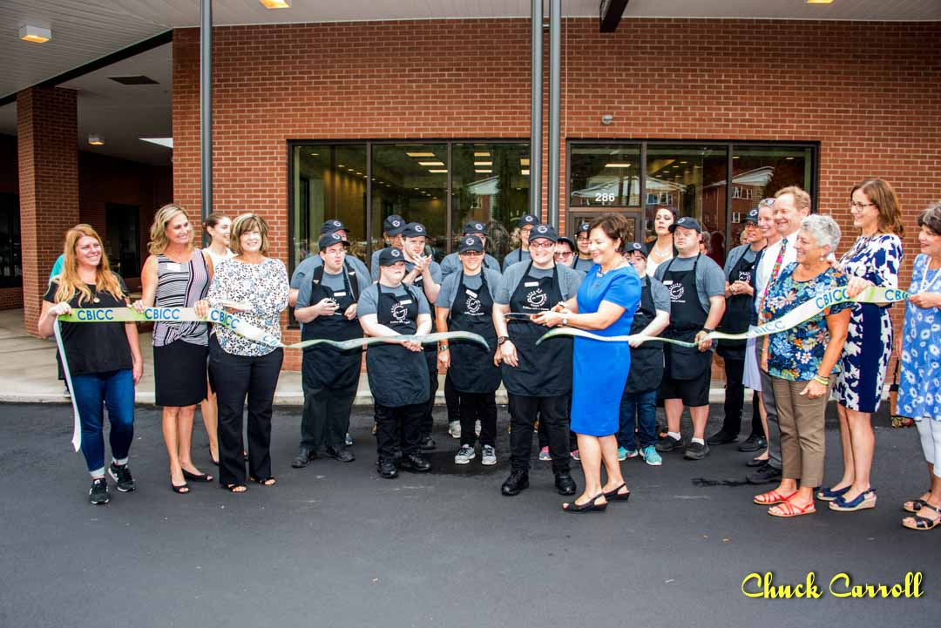
Centre Inspires

Slide 21
Centre Inspires
Letter of Intent opens June 8 and closes July 9
Open to 501(c)(3) nonprofit organizations, governmental units/agencies. Unincorporated groups may apply through a 501(c)(3) nonprofit organization that acts as a fiscal sponsor
To support innovative projects that have a significant impact in Centre County
Centre Foundation will award $100,000 in grant funding to support one successful proposal
After first round of proposals are reviewed, those that make it to Round 2 will be asked to complete a detailed application

Slide 22
Centre Inspires
ACRES Aquaponics - 2019
The Rivet - 2018
Good Day Café - 2017
Centred Outdoors - 2016
Food Centres - 2015
Book Benches - 2014

Slide 23
Centre Inspires Timeline
Monday, June 8, 2026 – Centre Inspires Round One (LOI) online application form opens.
Thursday, July 9, 2026– LOIs are due.
Monday, July 20, 2026 – Applicants selected to proceed are notified and invited to submit a full application.
Tuesday, September 1, 2026– Round Two full applications are due.
Thursday, October 8, 2026 – Selected Applications make 1st presentations.
Monday, October 12, 2026 – Finalists are notified.
Thursday October 22, 2026, 5:00-7:00 pm – Finalists present to Centre Foundation’s Board in person at Old Gregg School in Spring Mills.
Tuesday, December 8, 2026 – Centre Inspires grant recipient will be announced at Centre Foundation’s Annual Holiday Party. At least one representative from your organization must be present.

Slide 24
Centre Inspires Questions?

Slide 25
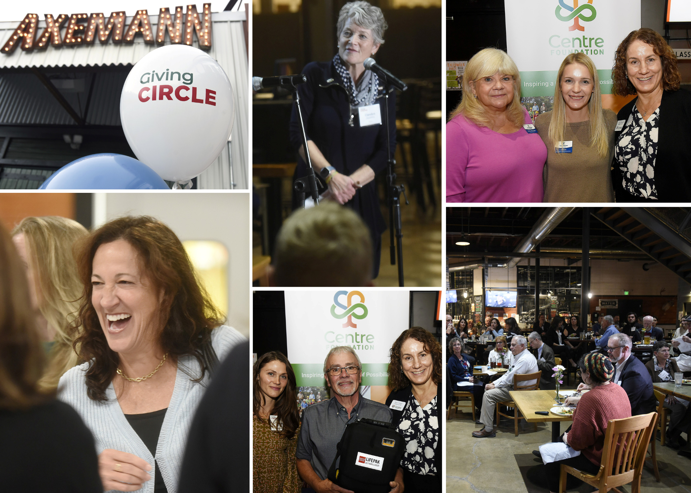
Centre Circle Grants
Giving Circle
Grants

Slide 26
Giving Circle
Centre Foundation’s membership-based grantmaking group
Members pool their resources to award grants to Centre County nonprofits
Since 2006, the Giving Circle has awarded over $267,000 in grants
Interested in joining? Visit or website or contact Kerry Tolton, Development and Stewardship Director, Kerry@centrefoundation.org
Notes:
GC is a membership based grant making group of generous community members. They pay an annual or monthly membership to join. These membership payments get pulled to create grants for CC nonprofits. Anyone is welcome to become a member. Please reach out to KT if you would like more information on joining.

Slide 27
Giving Circle Grants
Application opens July 7 and closes August 20
Deadline to receive feedback: August 6
Open to 501(c)(3) nonprofit organizations for dynamic programs & projects serving Centre County
Three finalists present live pitches to the Giving Circle membership
Provides one $10,000+ grant and two grants for runners-up
Finalists must skip two years before reapplying
Notes:
Nonprofit orgs for dynamic programs or projects serving CC. Usually our GC members are looking for a new initiative or a significant expansion of an existing program. The GC members review all the grant applications and select their top 3 proposals. 3 finalists then present a live pitch to the GC members in October. The members vote that night and determine who will receive a $10,000 or more grant. All 3 finalists receive a grant.

Slide 28
2025 Giving Circle Finalists
Centre LifeLink EMS, Inc. – Ambulance Licensure Equipment
Sleep in Heavenly Peace – No Kid Sleeps on the Floor in our Town!
Centre Volunteers in Medicine – Rapid Point-of-Care Lab Expansion
2024 Giving Circle Finalists
The Makery of Central Pennsylvania – Joyful Job Training for Teens
Interfaith Human Services – Emergency Vehicle Repair
Centre Care Volunteers – Resident Greenhouses

Slide 29
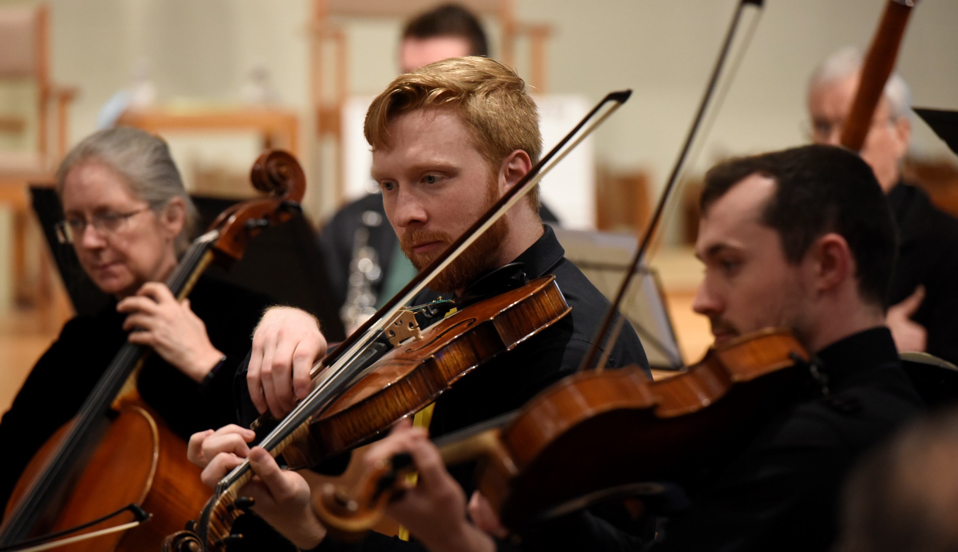
Field of Interest
Grants

Slide 30
Field-of-Interest (FOI) Endowment Funds
Centre Foundation manages 26 field-of-interest funds
Each FOI fund supports a particular cause or geographic area, spanning health and social services, education, youth development, animal welfare, the arts, and more
$183,130 was awarded to 40 nonprofits in 2025
Notes:
Each one supports a particular cause, population or geographic area depending on the interests and passion of the original donor. They span a wide range of causes and focus areas from health and human services to youth and educations the arts and more.

Slide 31
Field-of-Interest Grants
Application opens August 4 and closes September 24
Deadline to receive feedback: September 10
Open to 501(c)(3) nonprofit organizations, government agencies, municipalities and public-school districts. Unincorporated groups may apply through a 501(c)(3) fiscal sponsor.
Applicants may submit more than one application for separate programs or projects
Some FOI funds overlap; applicants are encouraged to request funding from multiple (relevant) funds
Notes:
Suggested maximum of three applications
Also, depending on the type of program you are running, there might be multiple FOI funds that are relevant to your proposal. We encourage you in completing the app to select as many funds that directly relate to your proposal.
As we review the applications and make funding decisions, the most important thing we look for is finding the best fit with the donors intent.

Slide 32
Health & Human Services
Counseling Service, Inc. Fund for the Provision of Direct Behavioral/ Mental Health Counseling
Ed and Charlene Friedman Family Fund for Housing, Food, and Health Services and Programs that Alleviate Poverty
J. Alvin and Vera E. Knepper Hawbaker Memorial for Vital Health and Education Services
William W. and Helen S. Litke Memorial Fund for Services and Programs for Individuals Who Have Hearing Loss
Denny Gioia and Judy Albrecht Endowment Fund for Services and Programs in the areas of Housing Insecurity, Food Insecurity and Health
Wayne Baumgardner Fund to provide food to the residents of Pleasant Gap
Connor-Grignano Family Fund for programs that provide services in the area(s) of healthcare and early childhood education – New 2026
Recovery Support Fund for programs that focus on research, education or treatment of substance abuse disorders – New 2026
State College Elks Loge #1600 Veterans Program Fund for services and programs that support veterans in Centre County and surrounding counties – New 2026
Notes:
Largest pool of funding

Slide 33
Children & Youth
Centre Children's Fund for At-Risk or Underserved Children
Centre County Medical Society Fund for Promoting Healthy Lifestyles in Children and/or Building Playground Equipment
Louis E. and Patricia H. Silvi Fund for Early Childhood Education
Barry and Patti Fisher Fund supports programs for children ages 11-17
State College Elks Lodge #1600 Youth Activities Fund for services and programs that support youth activities in Centre County – New 2026

Slide 34
Arts & Culture
Janet Atwood Fund for Arts Programs of Any Type
Patricia Farrell Music Fund
Proud to Be An American Fund for Patriotic Displays and Observances
Animals
Carolyn A. Petrus Memorial Seeing Eye Dog Fund
Donna L. Litke Occupational Horse Therapy Fund
Mattil Family Fund for Animal Welfare
Fur-Ever Support for Animals Fund

Slide 35
Geographic Focus
Philipsburg Area Fund
Andrew and Madaline Rishel Family Fund Penns Valley Church Outreach Programs
Ruth E. Rishel Charitable Fund for Penns Valley
Howard Area Lighthouse Fund for Programs and Projects in Howard
General Purpose
Ben Franklin Fund for Projects or Programs in Centre, Clearfield, Huntingdon, and Mifflin counties
Notes:
Ben Franklin Fund-general purpose fund that can support programs beyond CC including Clearfield, Huntingdon and Mifflin. This fund was actually created thru BF estate. In his will, Benjamin Franklin left $2,000 to the city of Philadelphia and $2,000 to the city of Boston with the direction that it could not be drawn on for 100 years and could not be distributed for 200 years. The funds were invested and after the first 100 years, the funds began making personal loans to the citizens of Philadelphia. After the 200 years were up, the State of Pennsylvania directed the money to be split between most of the community foundations in the state.

Slide 36
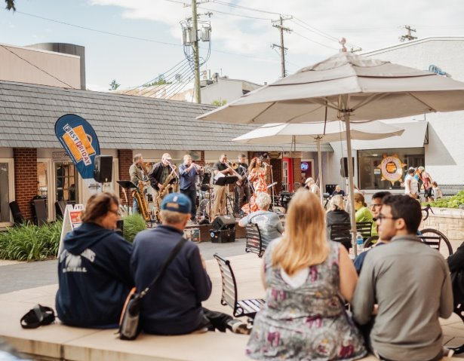
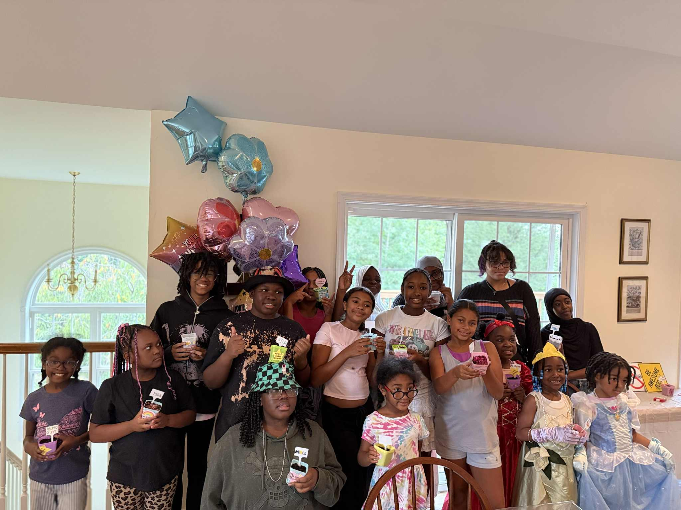
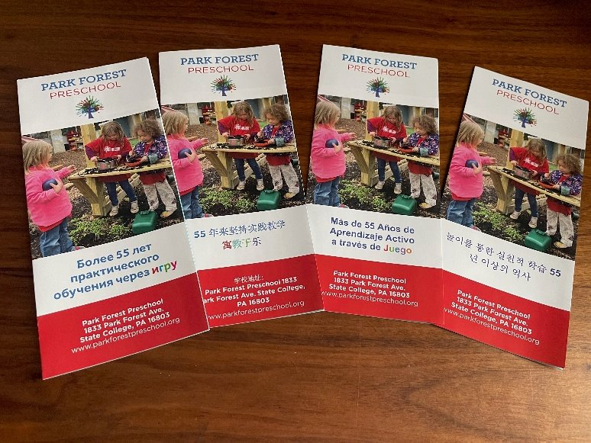
Equitable and
Inclusive Communities Fund

Slide 37
Equitable & Inclusive Communities Grant
Application opens September 29 and closes November 12
Deadline to receive feedback: October 29
Open to 501(c)(3) nonprofit organizations, government agencies, municipalities and public-school districts. Unincorporated groups may apply through a 501(c)(3) fiscal sponsor.
The Equitable and Inclusive Communities Fund was established in 2024 and is designed to support the advancement of equity-centered leadership and capacity building and address issues of Diversity, Equity, Inclusion and Belonging in Centre County.

Slide 38
2025 EIC Grant Recipients
Centre LGBT+ for their Pride Mind program which promotes the emotional well-being of LGBT+ individuals
Mid-State Literacy Council, Inc. to support cross-cultural communication and connection
Go ReEntry Specialists, Inc. for their reentry strategy group for incarcareted individuals

Slide 39
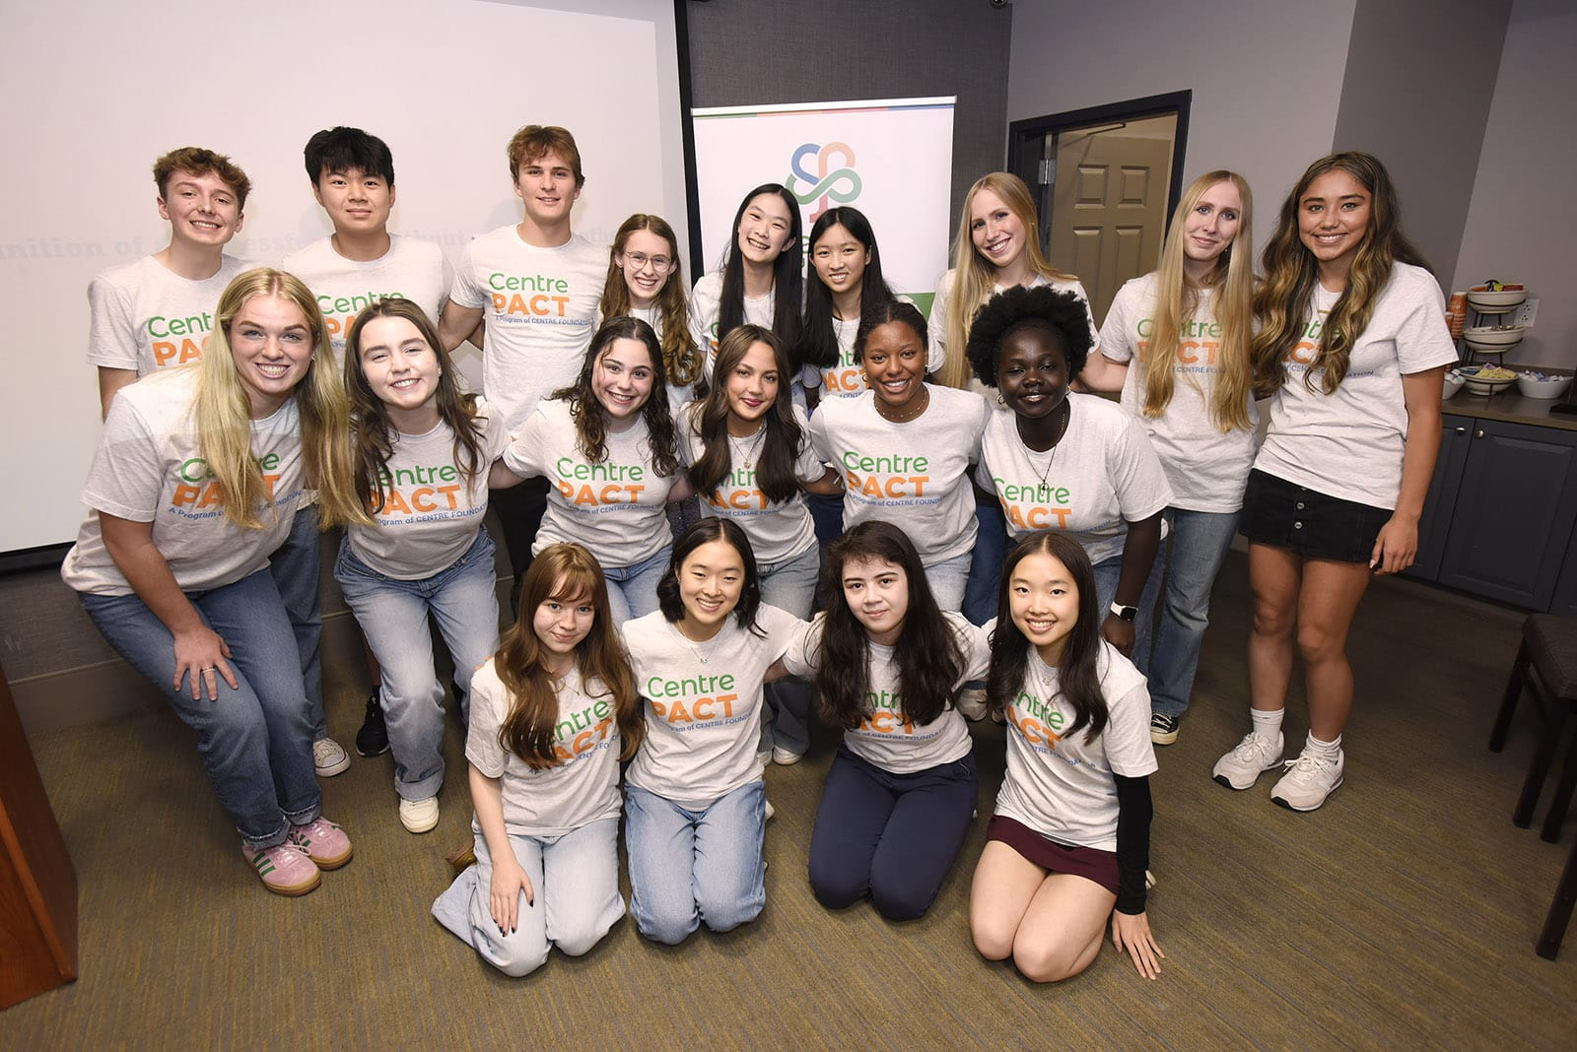
Centre PACT Grants

Slide 40
Centre PACT
Centre Foundation’s youth advisory council for Centre County high school students
Participants discuss issues facing their peers, learn about potential solutions that nonprofits offer, fundraise, and fund local programs
Since 2016, members of Centre PACT raised and granted over $77,000 to 37 local nonprofits
Have a student in grades 9-12 who might be interested? Contact Krista Williams, krista@centrefoundation.org
Notes:
Open to all CC high school students
Meet once a month during the school year
They decide what area they would like to focus on for the current year-education, equity, mental health

Slide 41
Centre PACT Grants
Application opens November 24, 2026 and closes January 7, 2027
Deadline to receive feedback: December 24
Open to 501(c)(3) nonprofit organizations for projects and programs that serve young people (Pre-K–12) in Centre County
Grant awards typically range from $500 – $3,000
Priorities shift annually but typically include mental health, school safety, and equitable educational opportunities
Notes:
Hand it over to Nathaniel to talk about CG

Slide 42
Scholarships for Individuals

Slide 43

Scholarships

Slide 44
Scholarships
Centre Foundation administers more than 150 scholarships and awards for school districts across Centre County and beyond
Over $450,000 awarded last year
Opportunities for high school seniors, adult learners, first responders, and more
Contact Krista Williams, Grants and Scholarship Coordinator, Krista@centrefoundation.org or your high school’s guidance office for more information
Notes:
Seniors can reach out to their HS guidance counselor for info on how to apply

Slide 45
Other Ways to Partner with
Centre Foundation

Slide 46
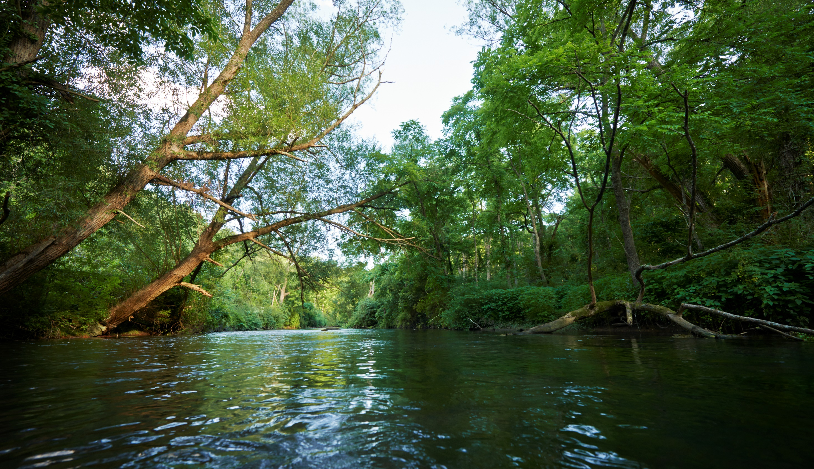
Endowment Funds

Slide 47
Endowment Funds
Serving the organizations and individuals who are passionate about the future of Centre County
Endowments provide consistent, long-term funding for your organization
Centre Foundation handles administration of endowments, including investment oversight, donation processing, and donor acknowledgement, etc.
Any 501(c)(3) public charity is eligible to open an endowment with Centre Foundation
Contact Kerry Tolton, Development and Stewardship Director, Kerry@centrefoundation.org
Notes:
A service we provide for orgs and individuals who are passionate about growing the future of CC and having an impact even after they are gone. Leaving a legacy.
Great for nonprofits b/c they provide consistent long term funding for your org to support your operations
CF handles all of the administration process of the endowment such as the investment oversight of the fund to the distribution and donor acknowledgement.

Slide 48
Get in touch!
Centre Foundation
Web: www.centrefoundation.org
Phone: (814) 237-6229
Grants and Scholarships: Krista Williams, Krista@centrefoundation.org
Endowments and Donors: Kerry Tolton, Kerry@centrefoundation.org
Centre Gives and Nonprofit Resources: Nathaniel Rasmussen, Nathaniel@centrefoundation.org
Notes:
Sign up for our newsletter

Slide 49
Questions?
Follow Us!
facebook.com/centrefoundation
instagram.com/centrefoundation

